Slide 1
KV6002 – Terms of Reference
Group 21

Slide 2
True North Surf Club
True North Surf Club is an independent Surf Club that is affiliated with Surfing England, and is based in North Tyneside.
They have requested the creation of a website for the surf club, which includes the following features:
- a gallery page to showcase their images.
- a contact form to provide a means of contacting the club.
- a membership sign up page, allowing potential new members to sign up for membership.
- an e-commerce page so that branded merchandise can be purchased from the club via the website.
The team consists of 5 members: Ben Kelly, Adrian Kucia, Kalina Filipowicz, Ed Davies and Charlie Callister.
The requirements for this project were largely gathered via the initial meeting with the client, with further requirements, such as _____, coming to light as we further investigated what the client truly needed. This investigation process allowed us to refine the identified requirements even further.

Slide 3
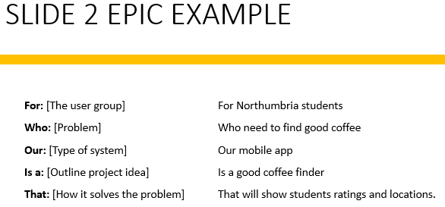
Slides 2&3
- Epic in specified format (AGILE).
- Team plan, outlining how features work together as a plan.
- Plan should include:
Details of the overall system.
Who will complete which subsystem.
How we intend to test the system.
Integration of the subsystems.
Project requirements – what equipment/software access do we need?
Potential commercial, economic, legal, ethical, social, professional factors.

Slide 4
Slides 2&3
- Epic in specified format (AGILE).
- Team plan, outlining how features work together as a plan.
- Plan should include:
Details of the overall system.
Who will complete which subsystem.
How we intend to test the system.
Integration of the subsystems.
Project requirements – what equipment/software access do we need?
Potential commercial, economic, legal, ethical, social, professional factors.

Slide 5
Slide 4
Intended users – 1 persona per group member

Slide 6
Persona #1
Intended users – 1 persona per group member

Slide 7
Persona #2
Intended users – 1 persona per group member

Slide 8
Persona #3
Intended users – 1 persona per group member

Slide 9
Persona #4
Intended users – 1 persona per group member

Slide 10
Persona #5
Intended users – 1 persona per group member

Slide 11
Slide 5
- Clear outline of the subsystem we are working on.
- 5 User stories (should be connected to each persona).
As a <role> I want <something> so that <benefit>.
- A clear outline of the tasks we intend to complete and the deliverables.

Slide 12
User Story #1

Slide 13
User Story #2

Slide 14
User Story #3

Slide 15
User Story #4

Slide 16
User Story #5

